Slide 1





Healthcare Predictive Analytics Project
An AI-powered model for early diabetes detection.

Slide 2



Project Overview
Revolutionizing Early Diabetes Detection
Introduced by
Omar Hammed
Mohammed Awad
John Hosny
Mahmoud Salah
Mahmoud Nagaty
Mohamed Aziz
AI-Powered Predictive Model
Lifestyle Indicators
Focus on non-invasive data to identify at-risk patients.
Leveraging artificial intelligence for proactive health insights.
Supporting Early Diagnosis
Improve quality of life and reduce healthcare burden.

Slide 3

The Global Challenge
The Rising Tide of Diabetes
1
Widespread Chronic Disease
A major health concern, especially in developing nations.
2
Alarming Statistics
537 million people with diabetes in 2021.
3
Projected Growth
Expected to rise to 643 million by 2030 without intervention.

Slide 4

Problem Statement
Current Barriers to Diagnosis
Access Barriers
Clinical Challenges
Limited testing access in remote areas; need for reliable self-assessment.
Difficulty for non-specialists to confirm early cases; risk of misdiagnosis.
Emergency Settings
Urgent need for quick, accurate assessments without full diagnostic tools.

Slide 5




Our Solution
AI-Based Predictive Model
Self-Assessment Tool
Empowers individuals to check risk at home using key health indicators.
AI-Powered Prediction
Analyzes data for high-accuracy diabetes likelihood prediction.
Healthcare Support
Assists medical professionals in rapid diagnosis and decision-making.

Slide 6
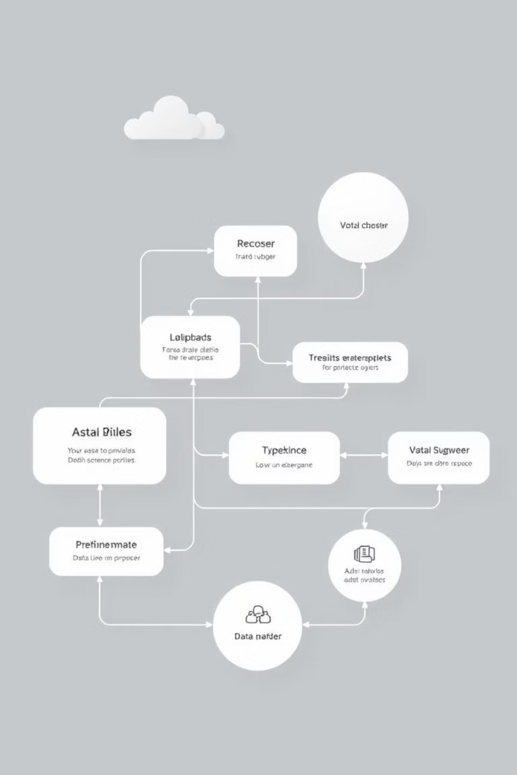




Project Methodology
From Data to Deployment
Data Collection & Preprocessing
Model Selection & Training
Evaluation & Tuning
Deployment & Maintenance
Our systematic approach ensures a robust and effective predictive model.

Slide 7

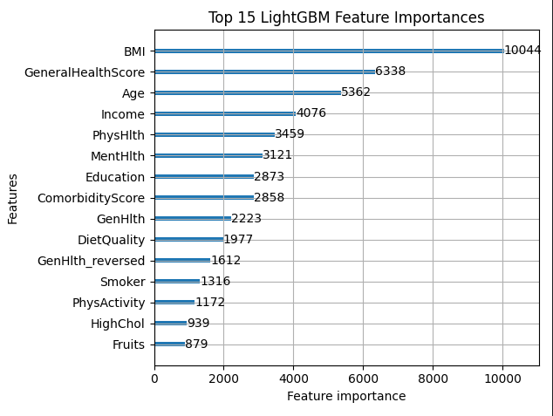
Data Insights
Behavioral Risk Factor Surveillance System (BRFSS)
Source: CDC BRFSS 2015
Largest continuous telephone health survey.
Focus on preventive health and risk behaviors.
253,680 records with 19 selected features.
Feature importance chart
Key Features
Target Variable: Diabetes Type 2 (DIABETE4)
Demographics: Age, Gender, Education, Income
Lifestyle: Exercise, Smoking, Diet (Fruits, Veg, Alcohol)
Health Indicators: BMI, General Health, Mental/Physical Health
Medical History: Cholesterol, Blood Pressure, CVD, Strokes

Slide 8




Preprocessing & Imbalance
Refining the Data
Missing Value Handling
KNN imputation for accuracy.
Feature Engineering
BMI categories, health scores, comorbidity scores.
Encoding
One-hot encoding for categorical variables.
Feature Selection
Retained 19 most relevant features.
Challenge: Class Imbalance (84% Non-diabetic, 1.8% Pre-diabetic, 13.9% Diabetic). Solution: Resampling techniques (SMOTE, SMOTEEN) applied.

Slide 9
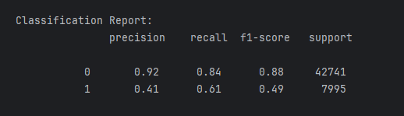
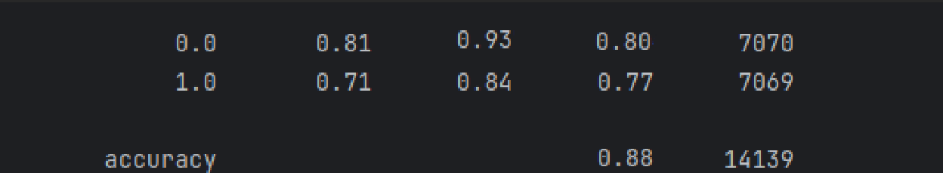
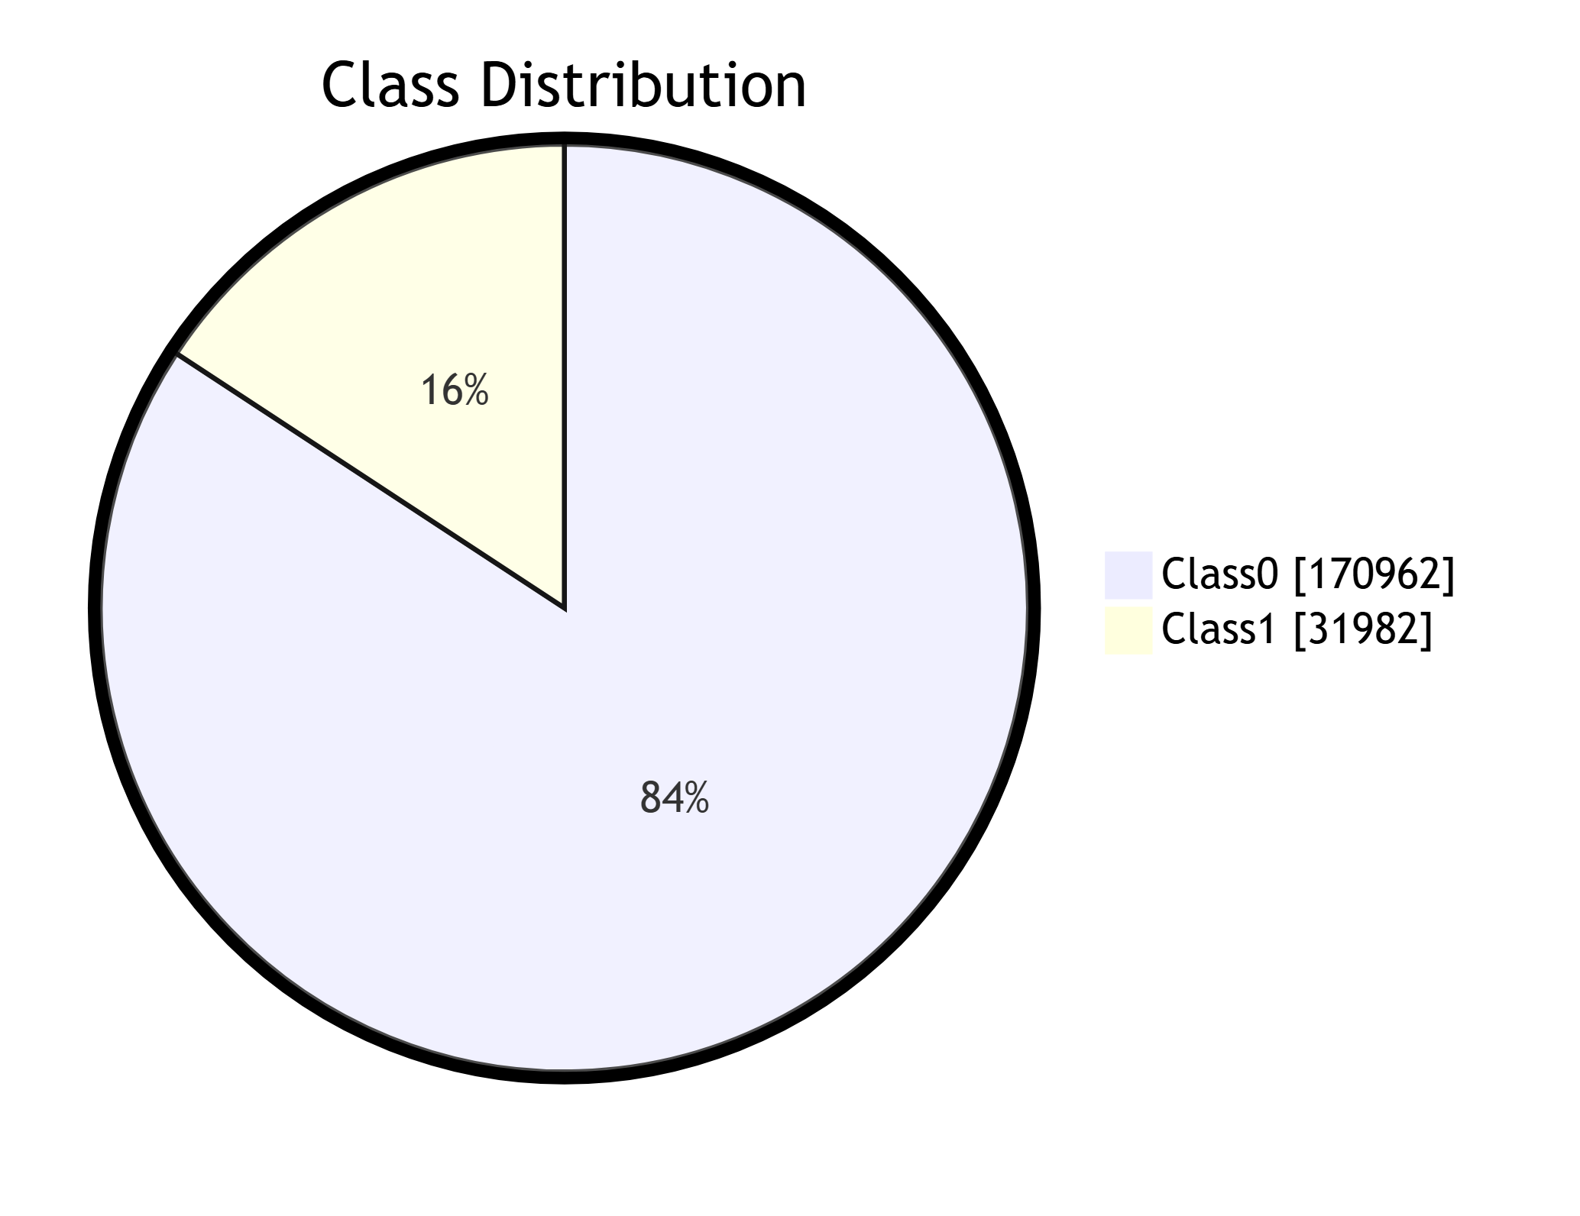
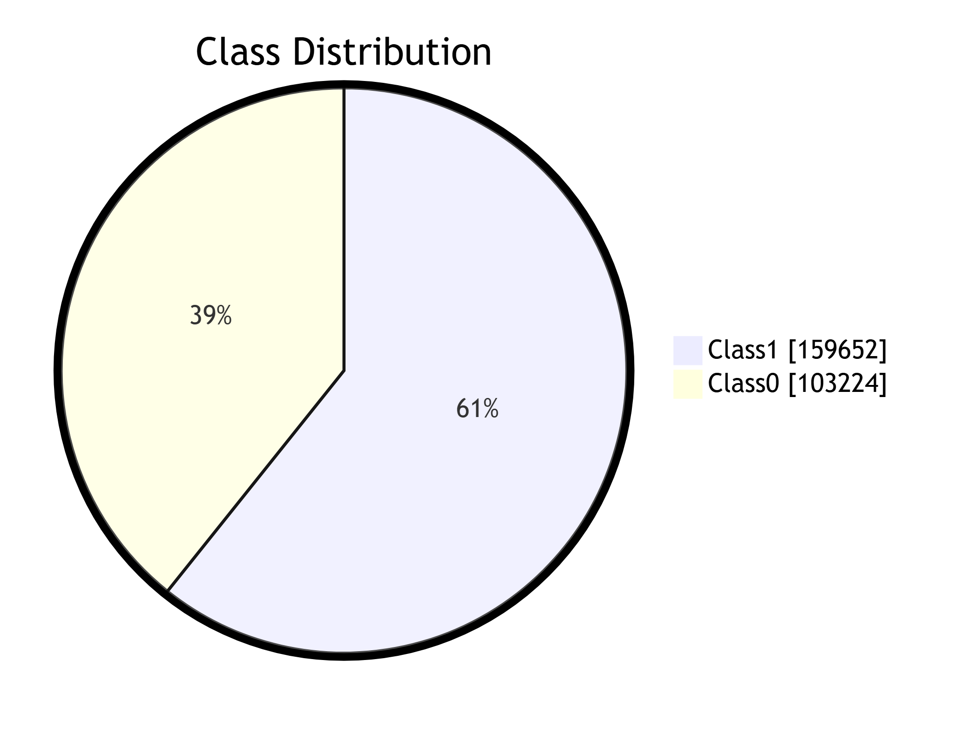
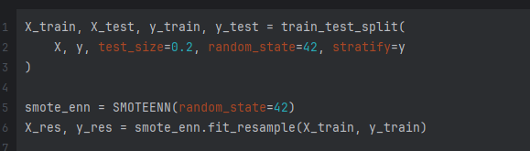
Before Using SMOTE + ENN the model shows extreme
Bias towards the majority class

Slide 10
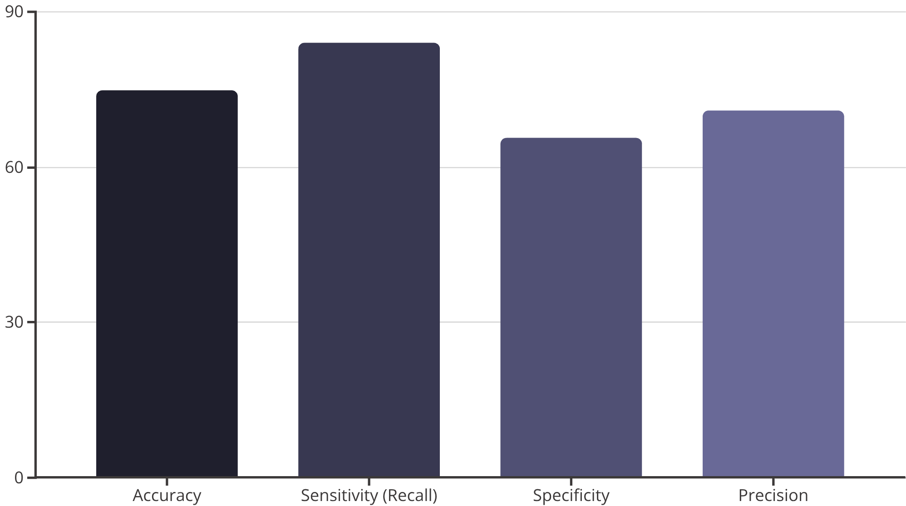
Model Performance
LightGBM: Our Top Performer
Key Achievements
Processed 253,680 health records.
Ensemble approach for robustness.
Selected LightGBM for superior results.
Optimized through feature binning, comorbidity scoring, and hyperparameter tuning.

Slide 11
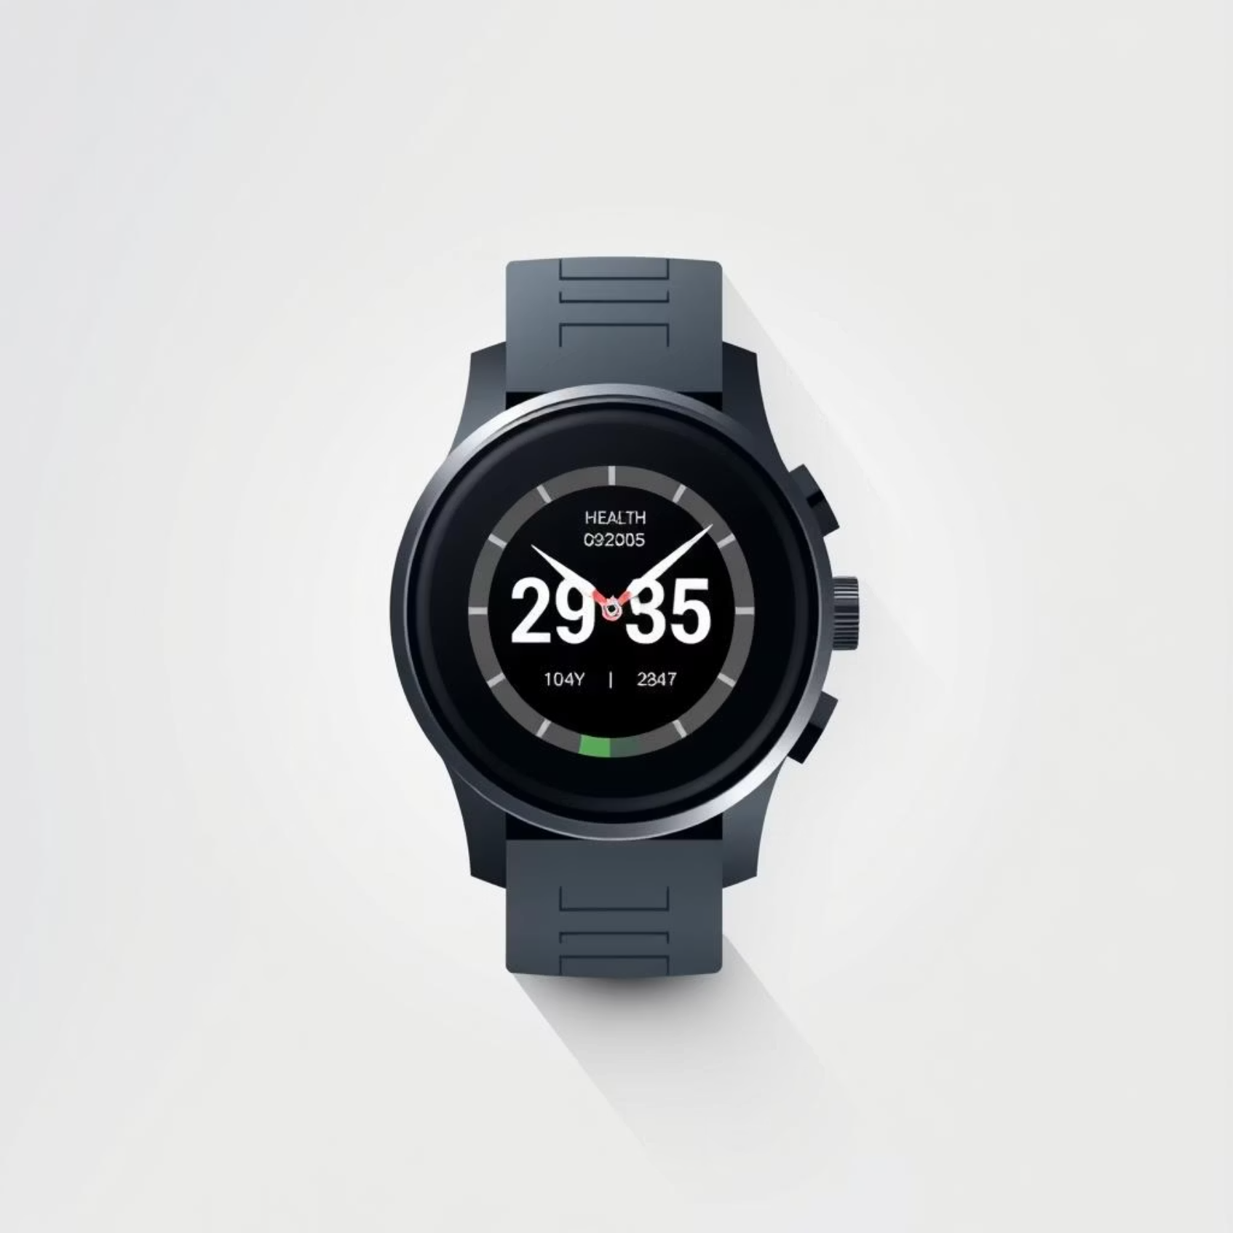
Next Steps
Future Vision & Impact
Planned Enhancements
Time Series System for trend analysis & early warnings.
Integration with wearable devices.
Multi-language support & Mobile application.
Healthcare provider portal for advanced tools.
Impact Potential
Early detection & intervention.
Reduced healthcare costs.
Improved patient outcomes & accessibility.
Support for underserved communities.
GitHub Repositories
Main Branch
Laravel front-end

